Slide 1
ANN (Approximate Nearest Neighbor)
Sarina Heshmati
Yasamin Tafakor
sarinaheshmatii@gmail.com
yasamintafakor@gmail.com

Slide 2
introduction

Slide 3

introduction
INTRODUCTION
01 of 20
Nearest Neighbors Motivation
What is KNN?
What is ANN?
KNN vs. ANN

Slide 4
KNN

Slide 5
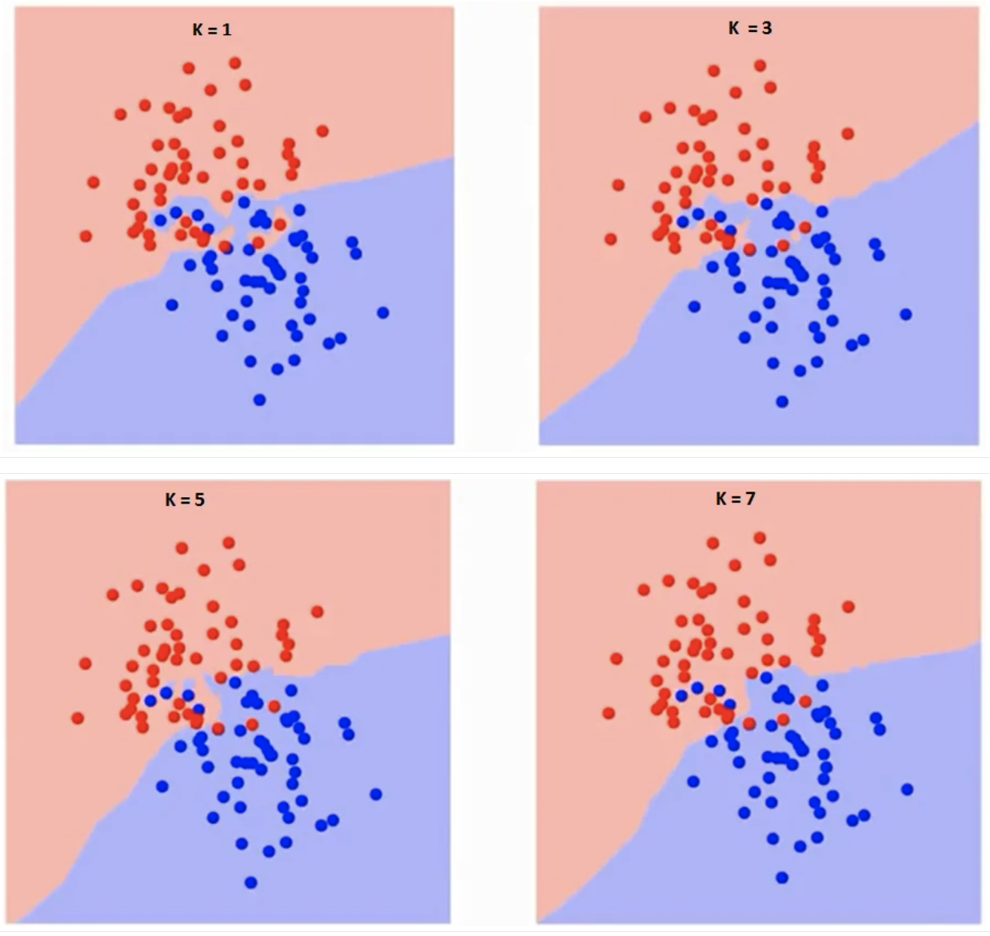
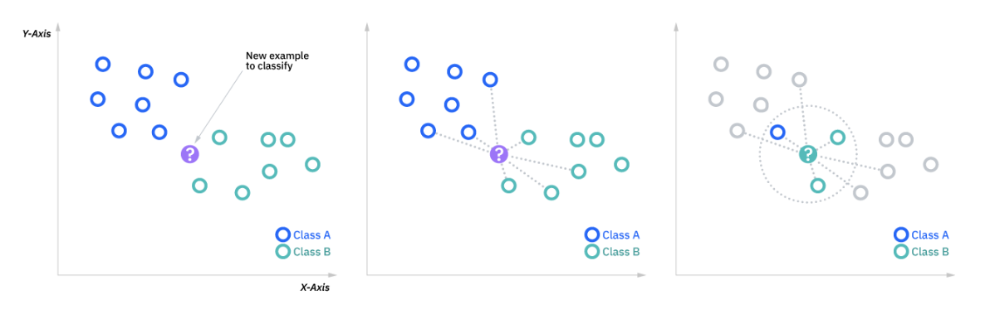
algorithm
KNN
02 of 20
Non-parametric
Supervised classifier
How does it work? (lazy learning)
Choosing the right K

Slide 6
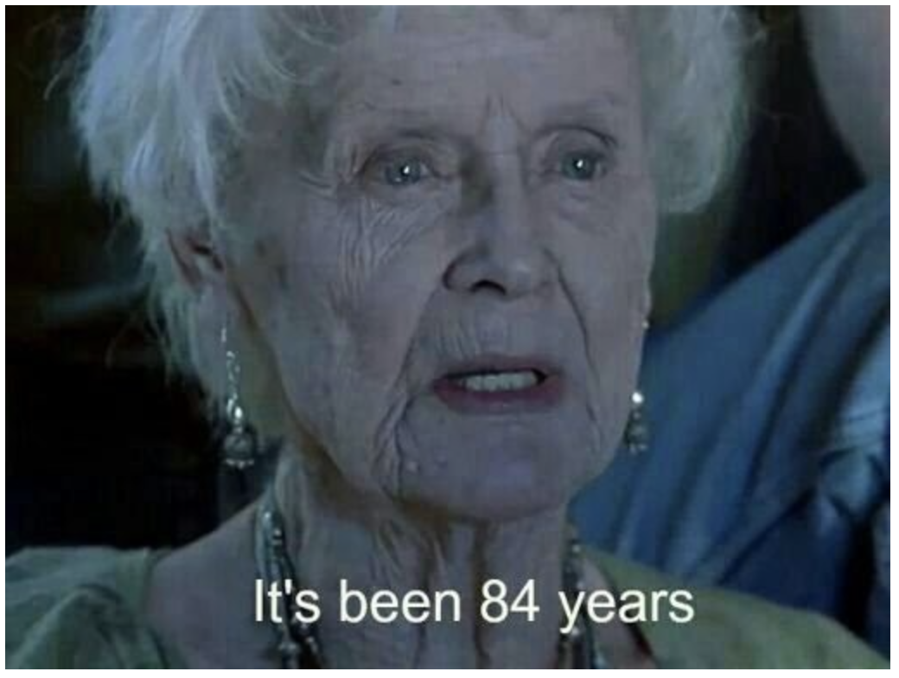
Pros & cons
KNN
03 of 20
pros
cons
Easy to implement
Adapts easily
Few hyperparameters
Highly time consuming (single query = O(N) )
Does not scale well (specific DS : ‘ball-tree’)
Curse of dimensionality
Prone to overfit

Slide 7
ANN

Slide 8
ANN
ANN
04 of 20
Basic intuition
Much faster – each query = O(log N)
Trade off between accuracy & time
KNN is not really an option to consider
Different implementations such as:
Facebook’s PySparseNN (for sparse interaction matrices)
Spotify’s annoy (Approximate nearest neighbor, Oh YEAH)

Slide 9
How does it work?

Slide 10
How does it work?
How does it work?
05 of 20
Annoy
The explanation will be in 2D
It will apply to much higher dimension
Goal : to build a data structure that let us find the nearest points to any query points in sublinear time
Its gonna be a Tree!
A binary tree that each node is a random split

Slide 11
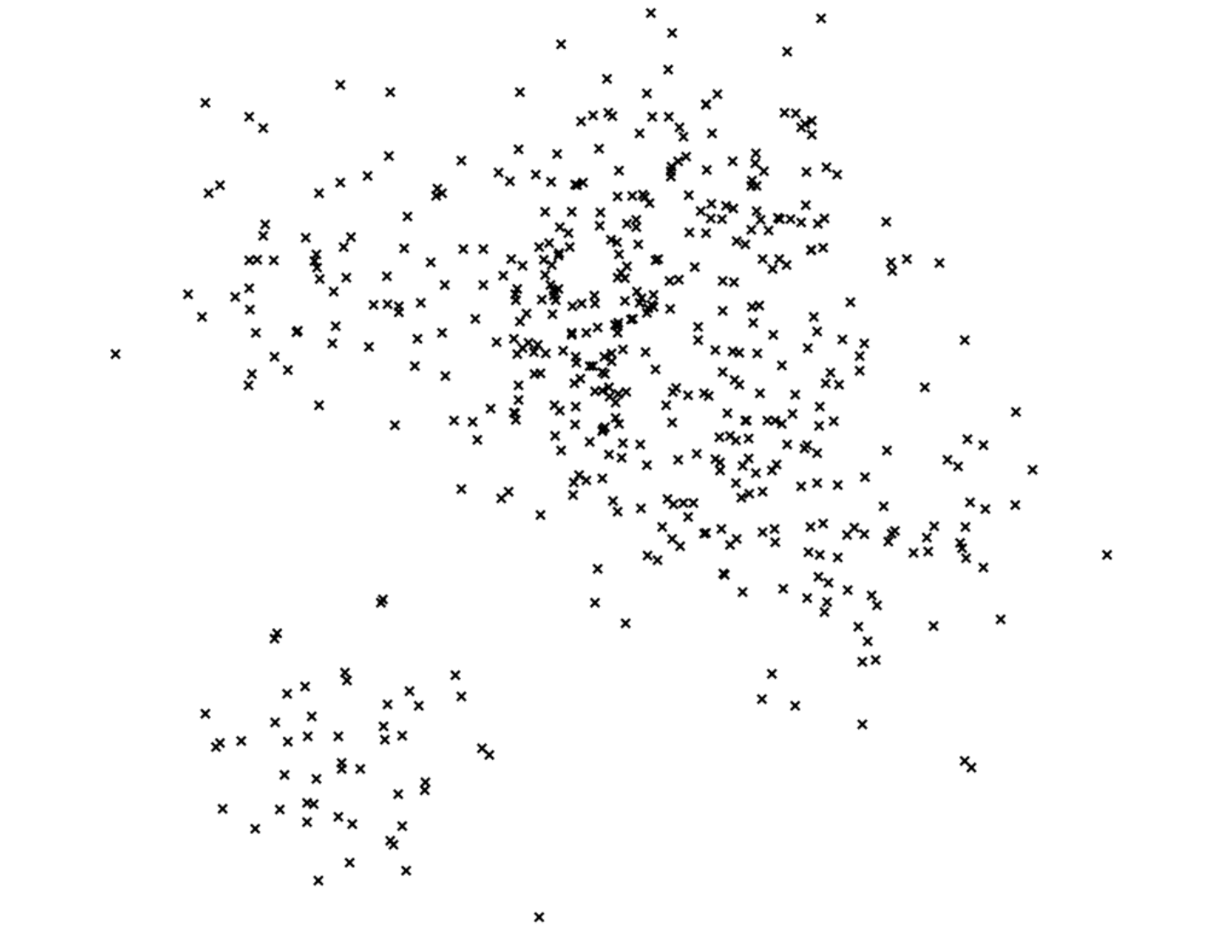
How does it work?
06 of 20

Slide 12
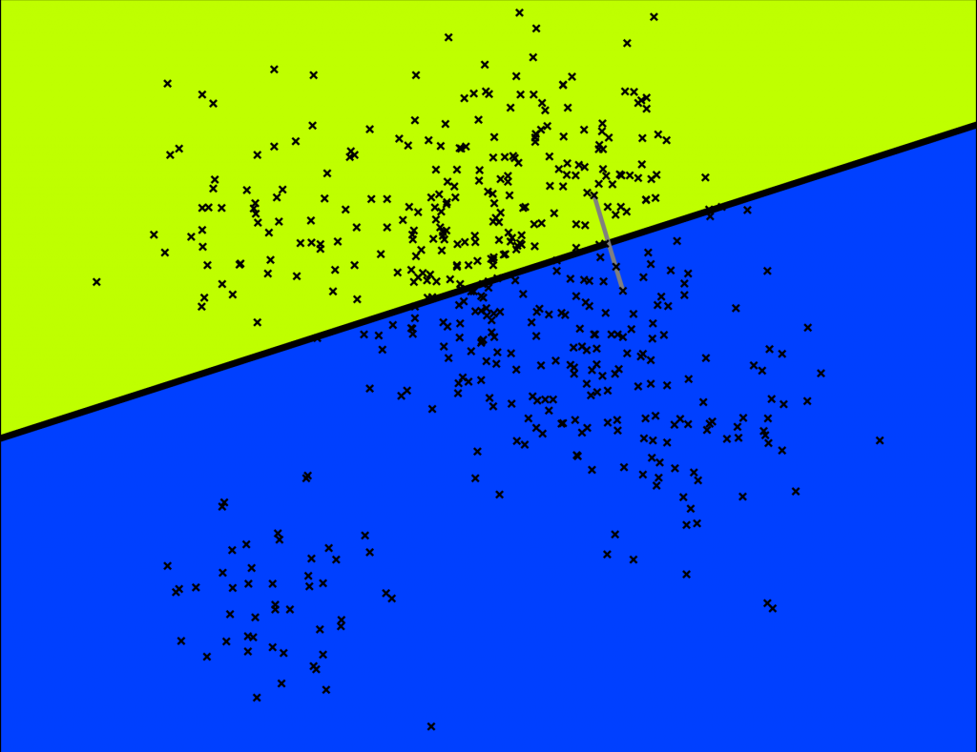
Preprocess
How does it work?
07 of 20
pick two points randomly and then split by the hyperplane equidistant from those two points

Slide 13
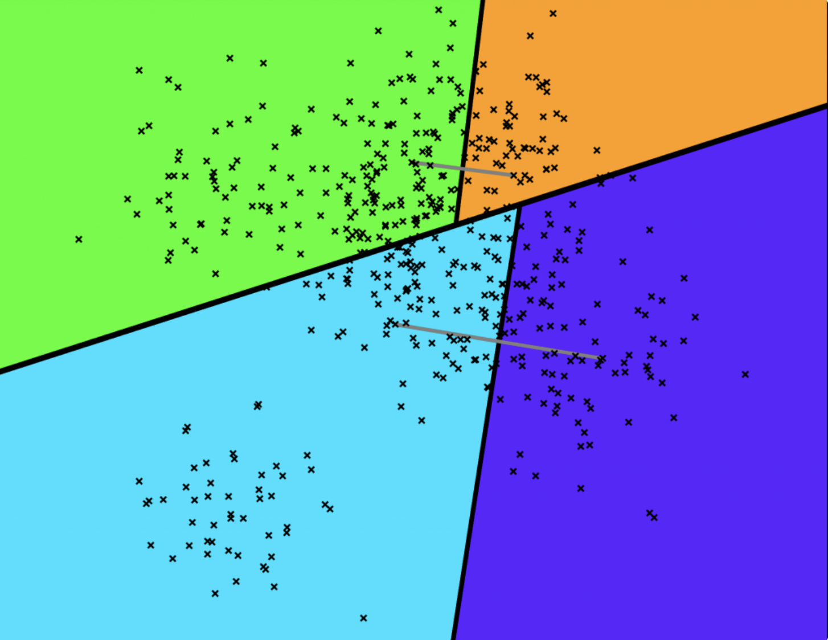
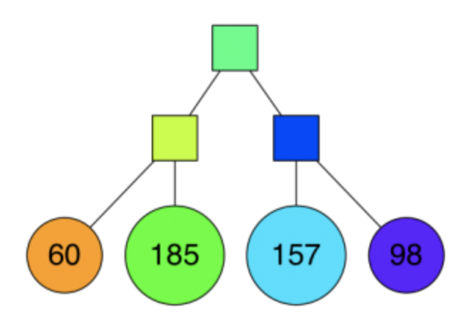
Preprocess
How does it work?
07 of 20
keep splitting each subspace recursively

Slide 14
Preprocess
How does it work?
07 of 20
keep splitting each subspace recursively
This is our tree so far!

Slide 15
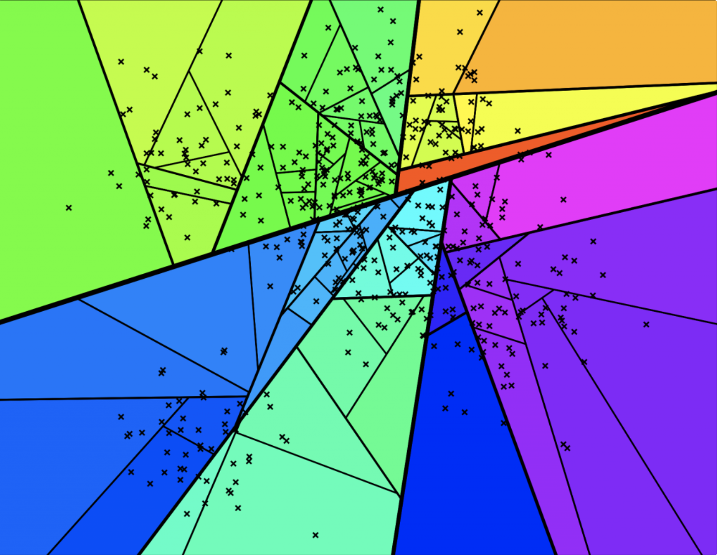
Preprocess
How does it work?
08 of 20
We keep doing this until there's at most K items left in each node (K=10)

Slide 16
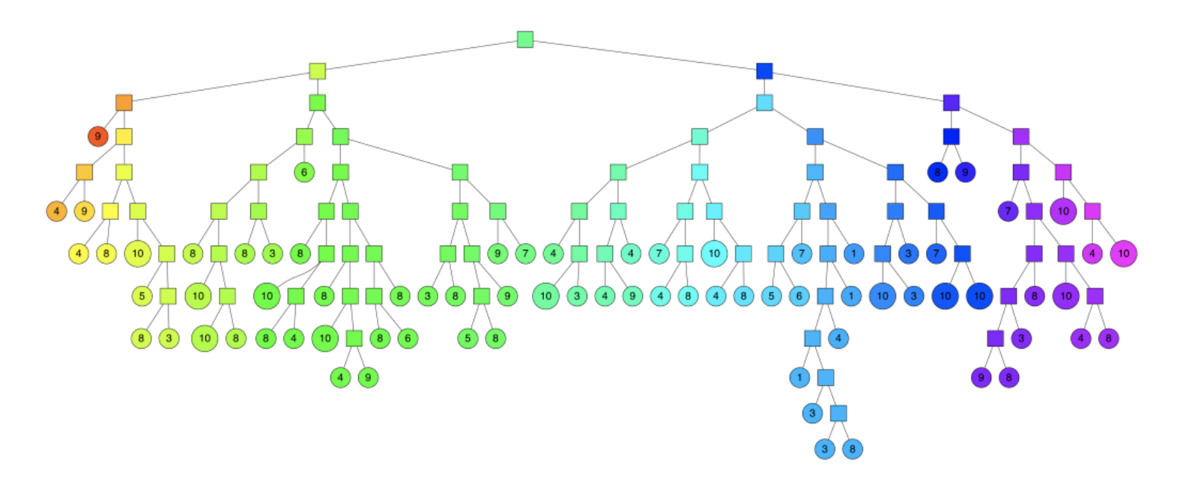
Preprocess
How does it work?
09 of 20
Final tree

Slide 17
Preprocess
How does it work?
10 of 20
Hyperplane; to figure out which side of the hyperplane to go
The final spaces

Slide 18
Preprocess
How does it work?
11 of 20
The resulting binary tree partitions the space
points that are close to each other in the space are more likely to be close to each other in the tree
In other words if two points are close to each other in the space, it's unlikely that any hyperplane will cut them apart
Searching for a point can be done in logarithmic time since that is the height of the tree

Slide 19
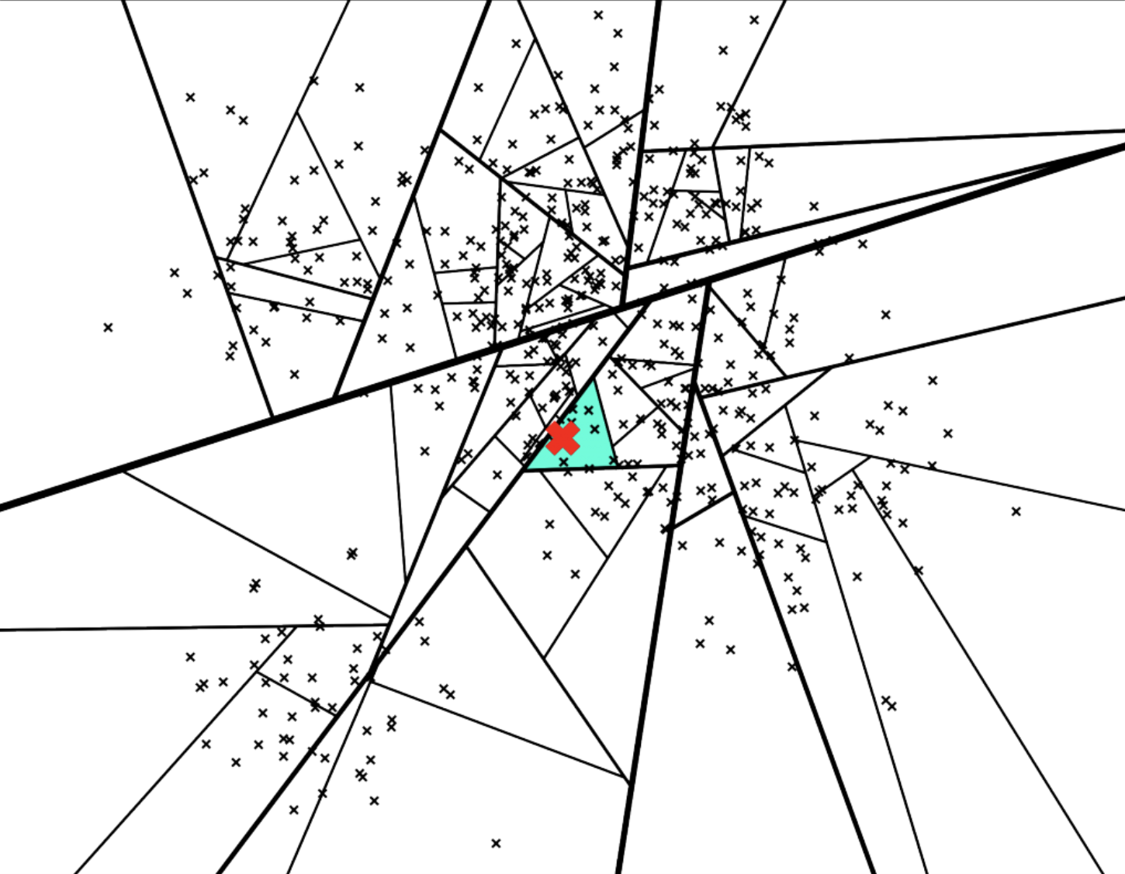
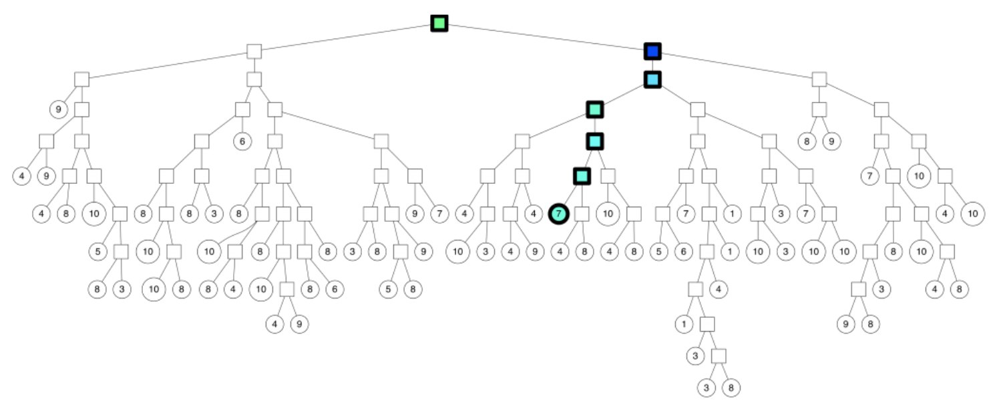
query
How does it work?
12 of 20

Slide 20
Not great
How does it work?
13 of 20
What if we want more than 7 neighbors?
Some of the nearest neighbors are actually outside of this leaf polygon

Slide 21
Improvements

Slide 22
Trick I
Improvements
14 of 20
We go down on both sides of a split if we are “close enough”
We acknowledge a threshold of how far we are willing to go into the “wrong” side of the split. If the threshold is 0, then we will always go on the “correct” side of the split.
So instead of just going down one path of the binary tree, we will go down a few more

Slide 23
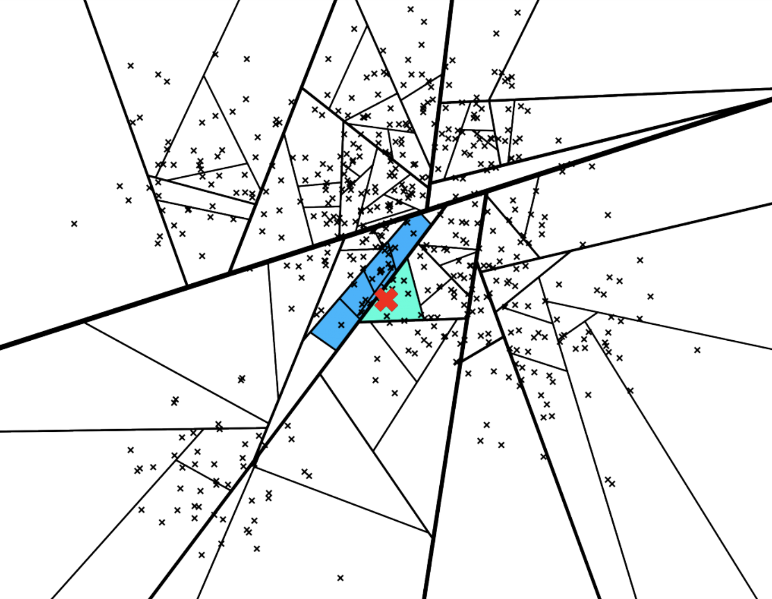
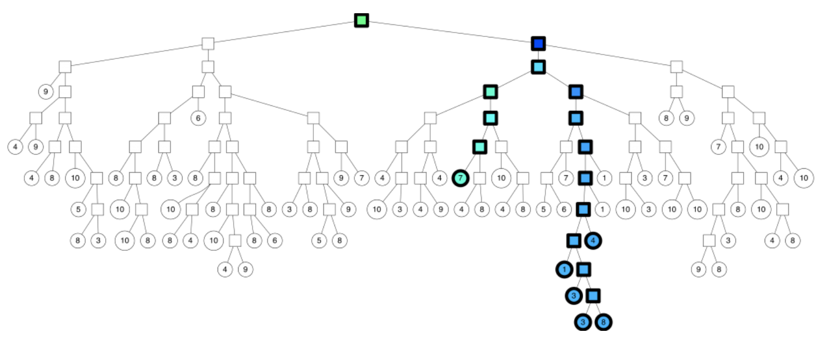
Trick I
Improvements
15 of 20

Slide 24
Trick II
Improvements
16 of 20
Build a forest of trees
Search down all these trees at the same time
If we look at the union of the leaf nodes we get a pretty good neighborhood

Slide 25
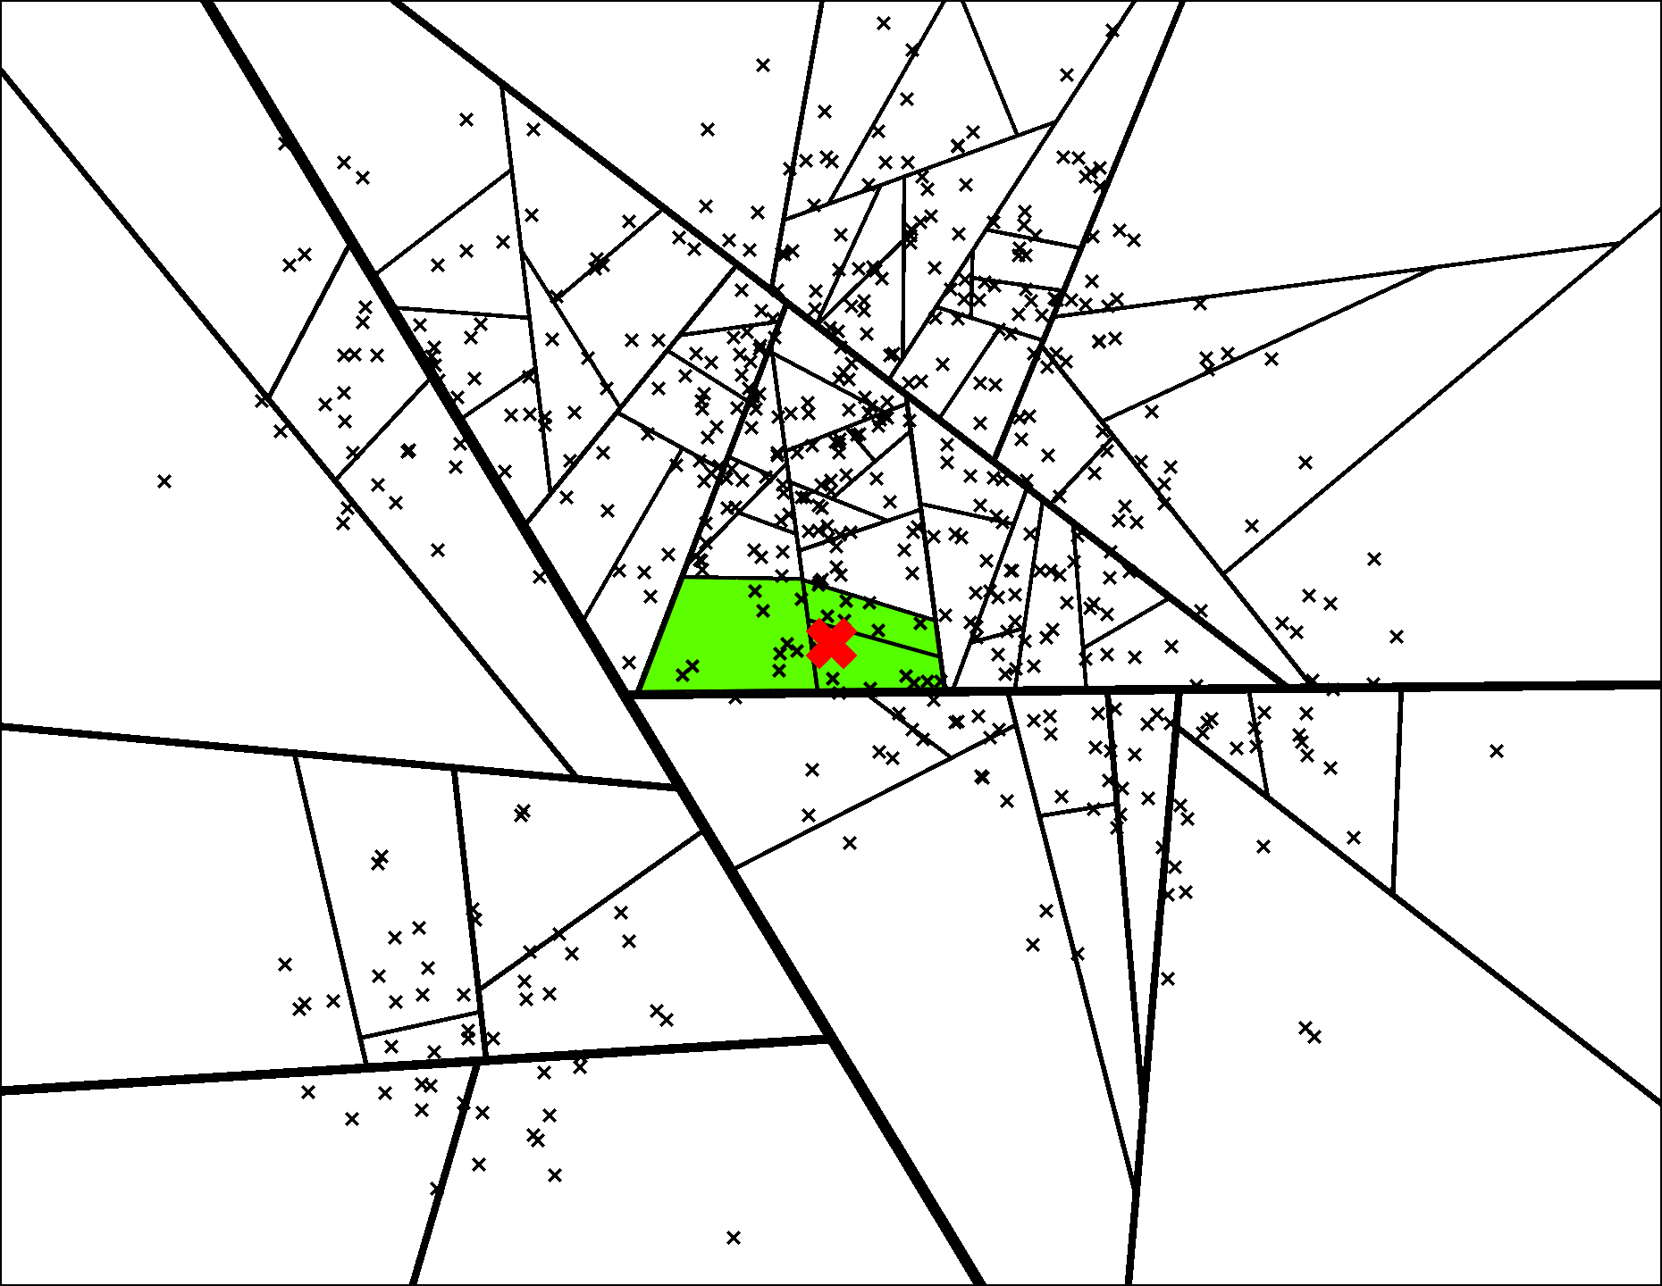
Trick II – the forest
Improvements
17 of 20

Slide 26
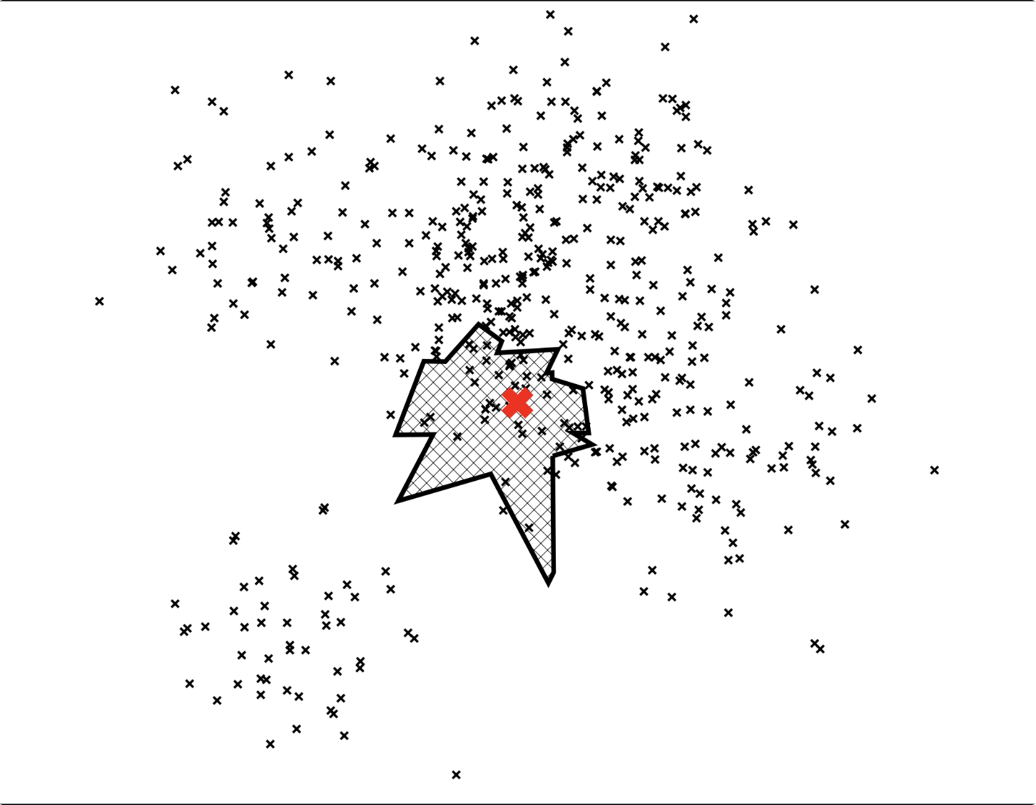
Trick II – union of the leaves
Improvements
18 of 20

Slide 27
Final step

Slide 28
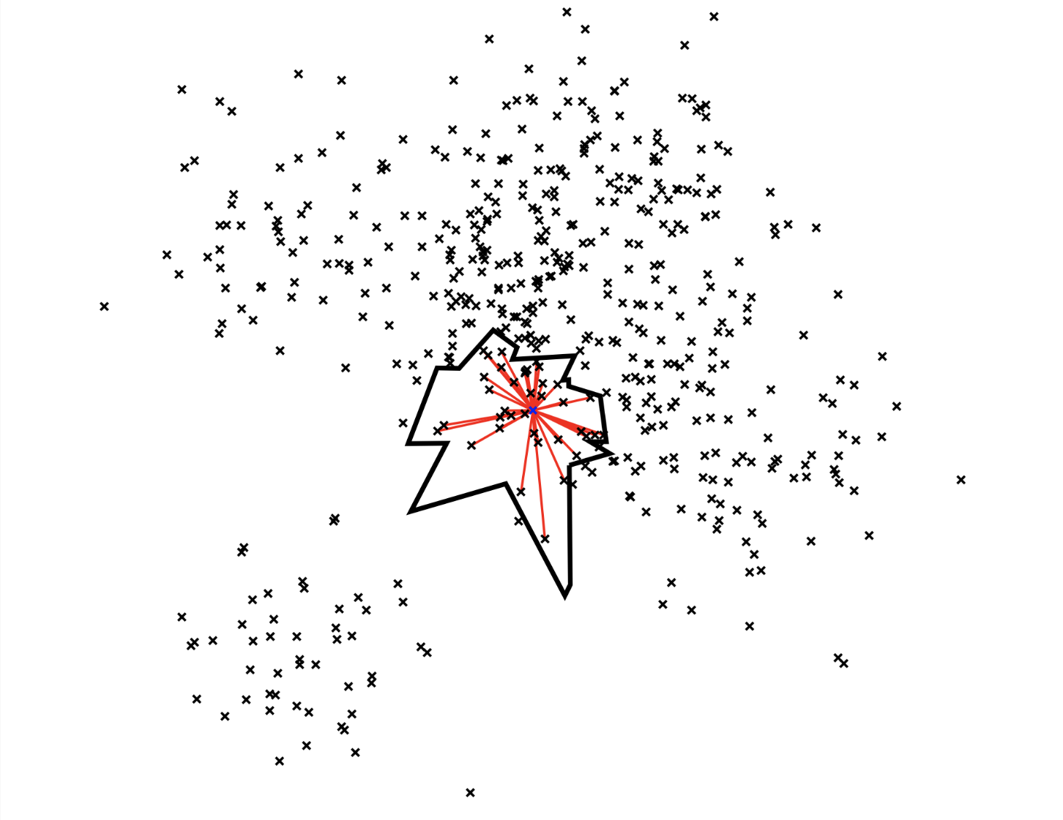
Final step
Final step
19 of 20
Now we have a small set of points that are almost the closest ones
We only compute the distance of these points (instead of the whole data set)
And just like KNN we rank the distances and so on!

Slide 29
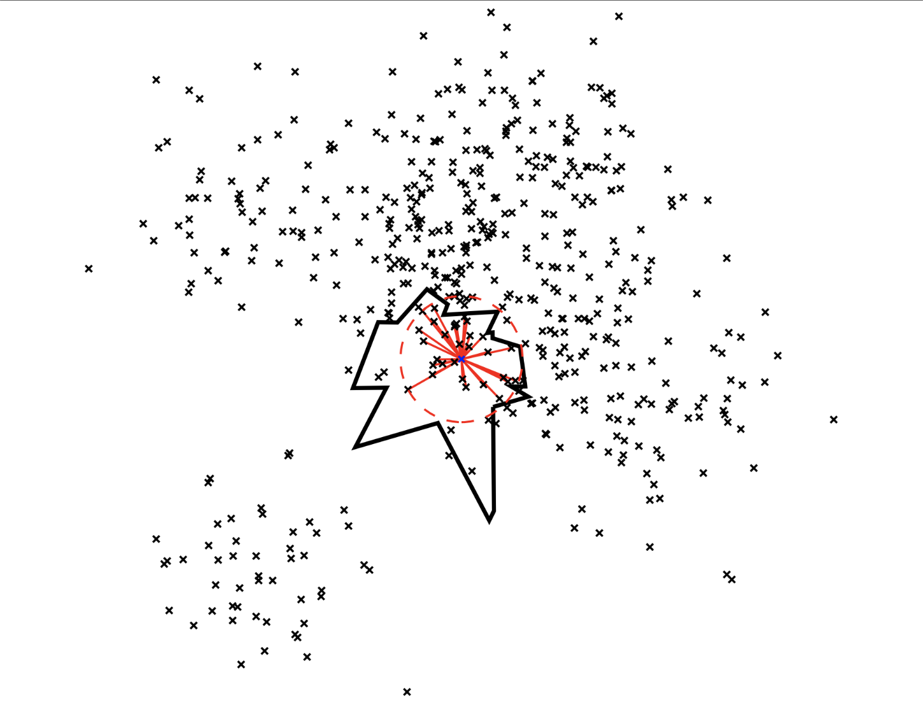
Final step
Final step
19 of 20
The trade off between time and accuracy

Slide 30
Final words

Slide 31
refrences
FINAL WORDS
20 of 20
https://www.ibm.com/topics/knn#:~:text=The%20k%2Dnearest%20neighbors%20(KNN,used%20in%20machine%20learning%20today.
https://blog.faradars.org/introduction-k-neighbours-algorithm-clustering/
https://www.geeksforgeeks.org/k-nearest-neighbours/
https://www.linkedin.com/pulse/approximate-nearest-neighbors-ann-mina-ashraf-gamil/
https://erikbern.com/2015/10/01/nearest-neighbors-and-vector-models-part-2-how-to-search-in-high-dimensional-spaces.html

Slide 32
Thanks for your attention. Contact info:
FINAL WORDS
20 of 20
sarinaheshmatii@gmail.com
yasamintafakor@gmail.com

